Slide 1
Interactive optimization for early-stage urban planning
Motivation for the Scenario ADE
7.12.2017
CityGML workshop
Nils Schüler
Sébastien Cajot

Slide 2
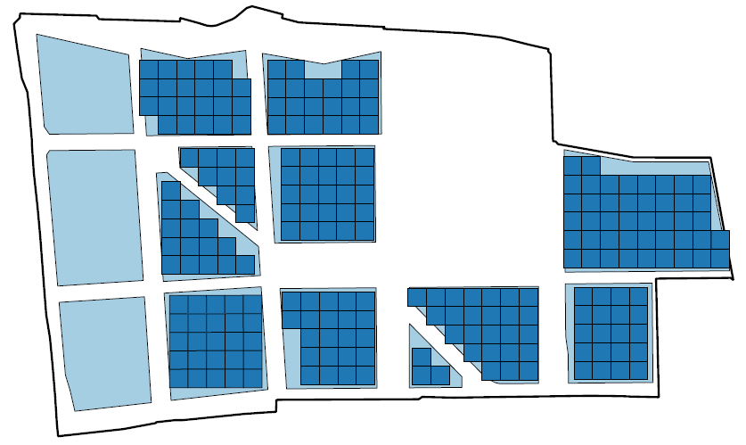
Early-stage urban planning

Slide 3
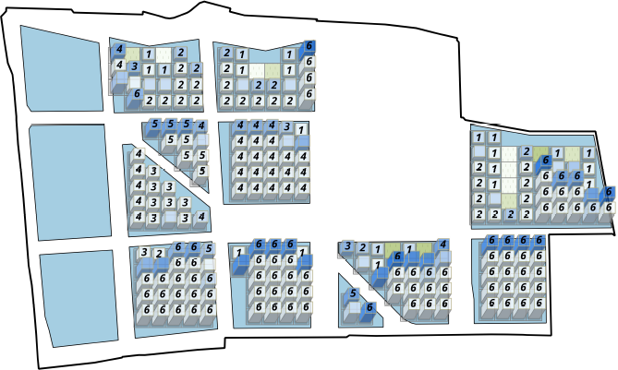
Early-stage urban planning

Slide 4
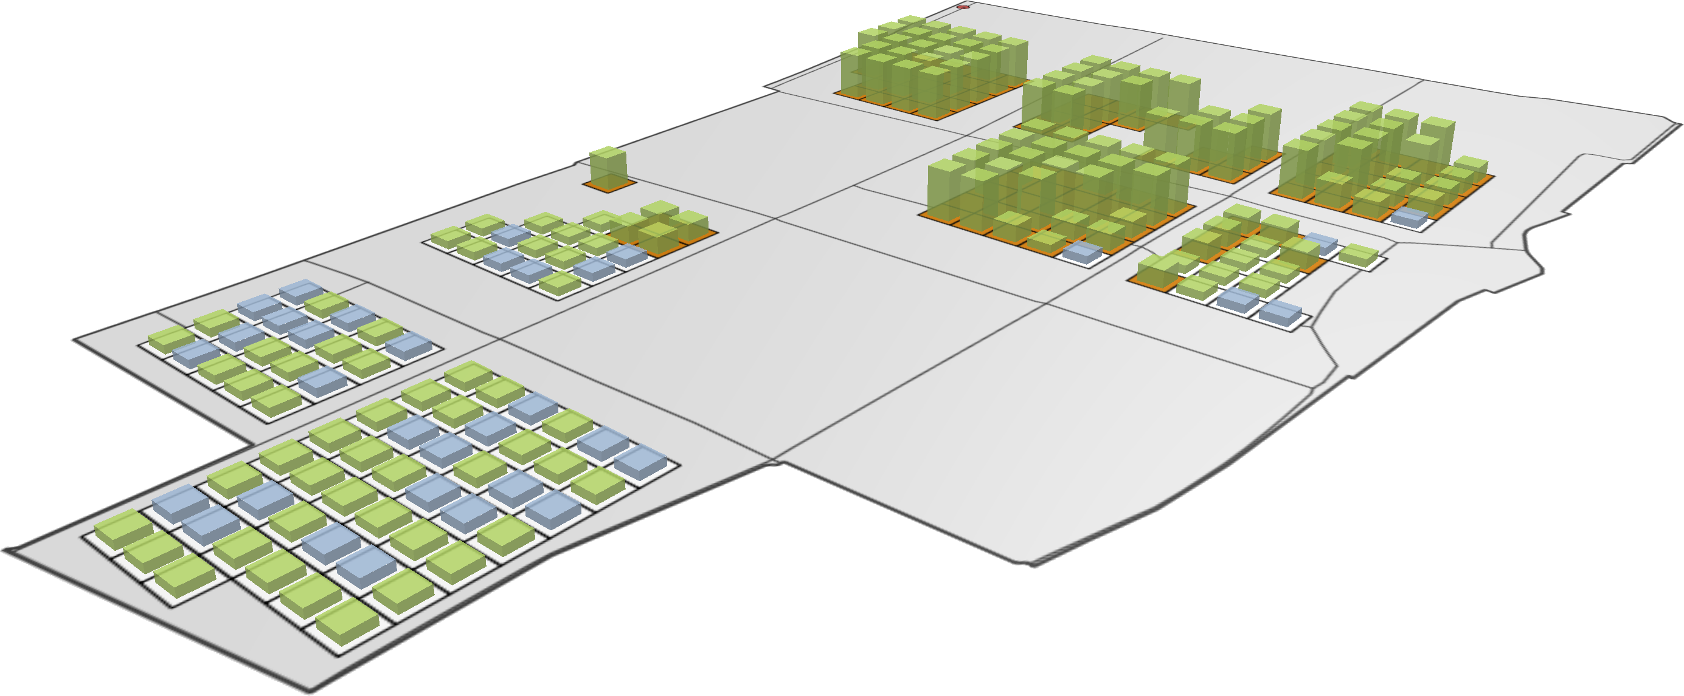
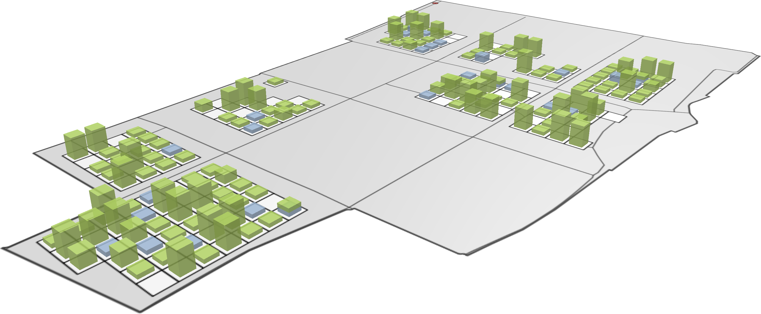
Practice of urban planning
Alternative-driven
Value-driven
Alternative
SOC
ENV
Values
FORM
ENER
ECON
Notes:
Alternative driven

Slide 5
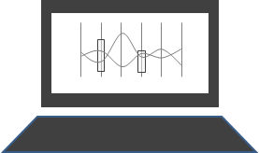
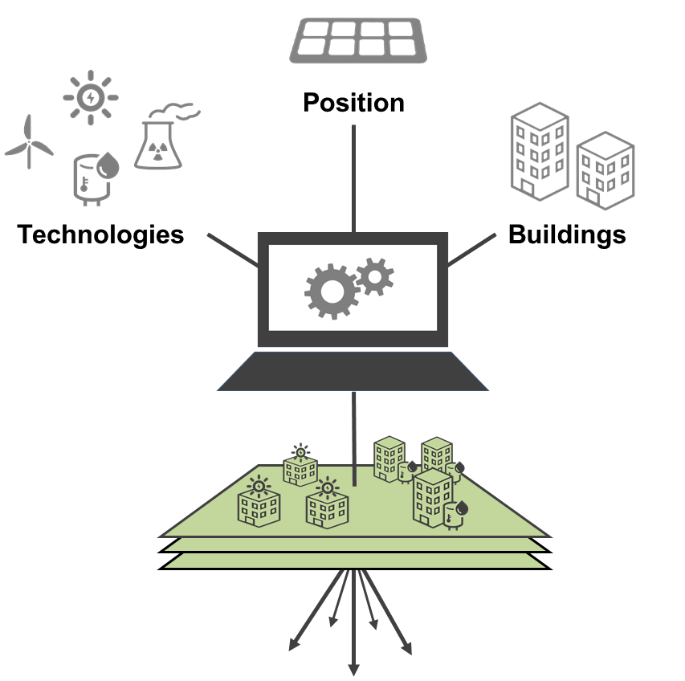
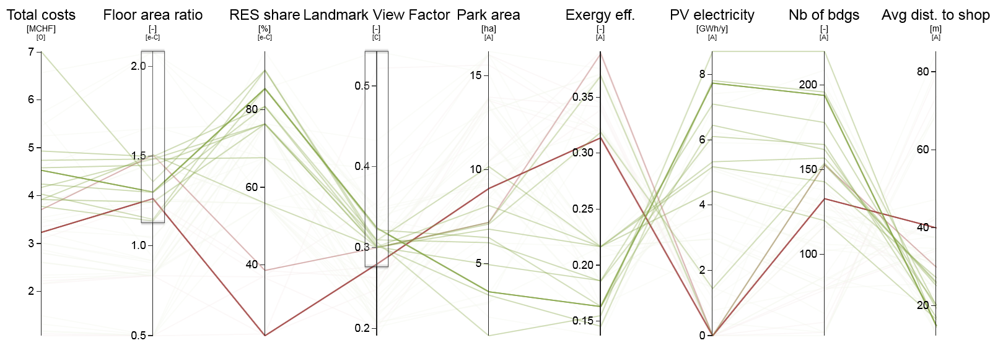
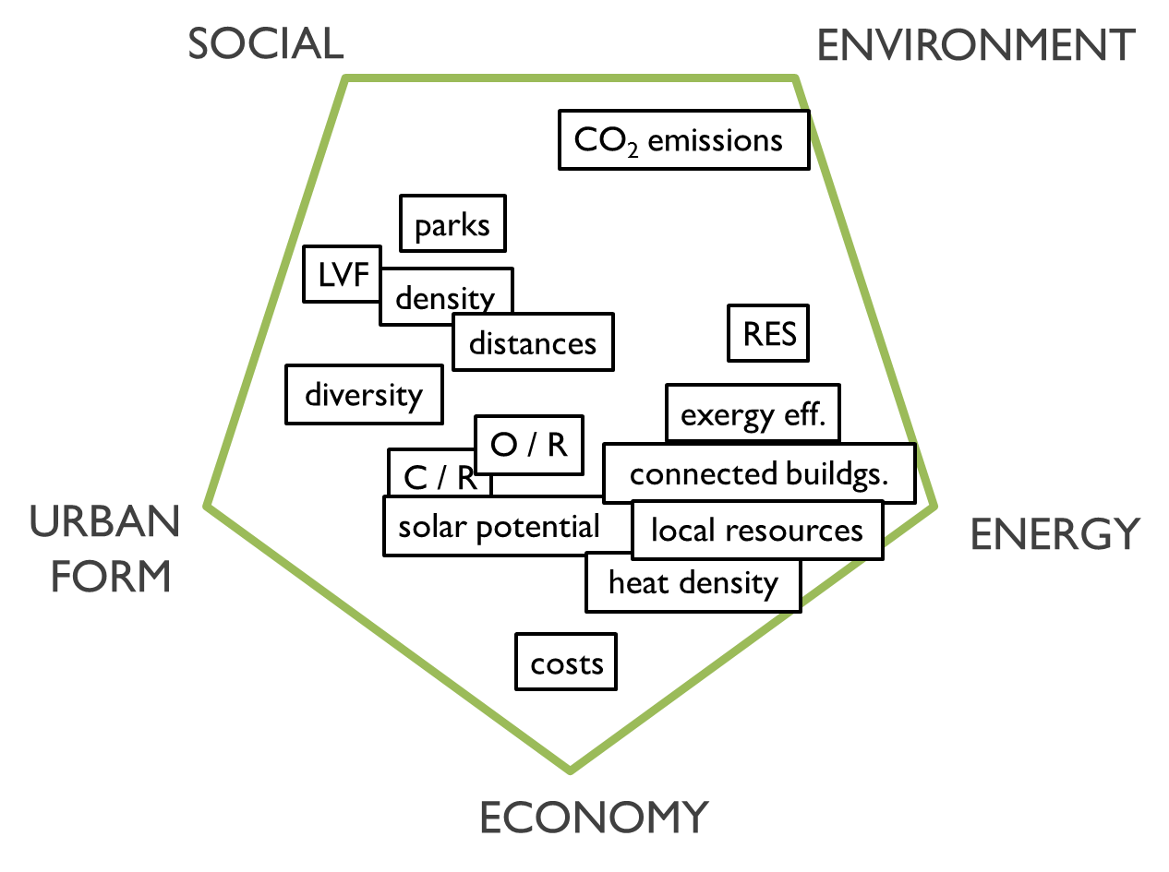
Interactive optimization
optimized results
interaction
optimisation
user preferences
i
o
user-driven
i
o
i
computer-driven
Decision

Slide 6
How it works
www.urbio.ch

Slide 7
Style

