Slide 1
Alexandru Nichersu
Andreas Koch
Common workshop of the Utility Network ADE and the Energy ADE
EnergyADE
UtilityNetworkADE

Slide 2
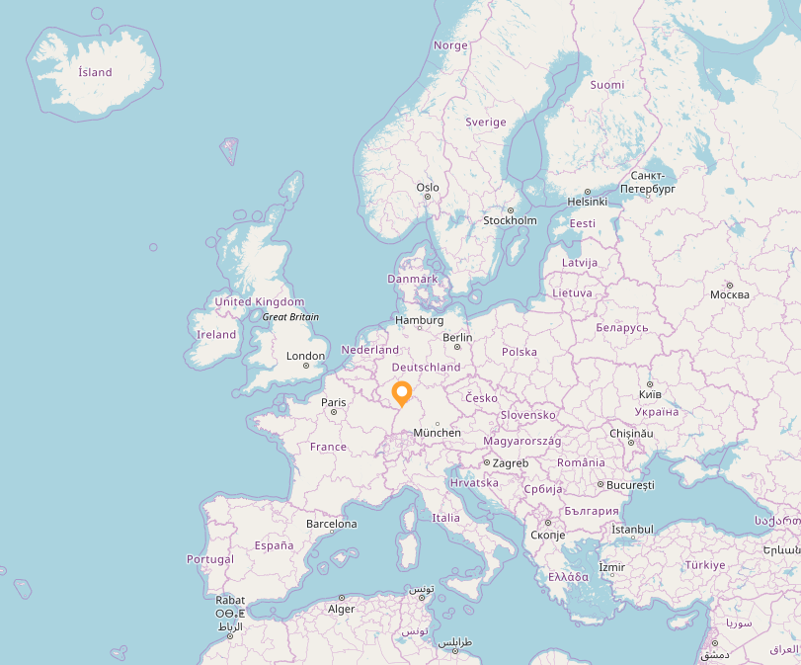


            EIFER
            EDF&KIT
KIT facts and figures:
9.239 Employees
25.892 Students
€ 851 million
EDF R&D facts and figures:
2,100 employees
€ 572 million

Slide 3
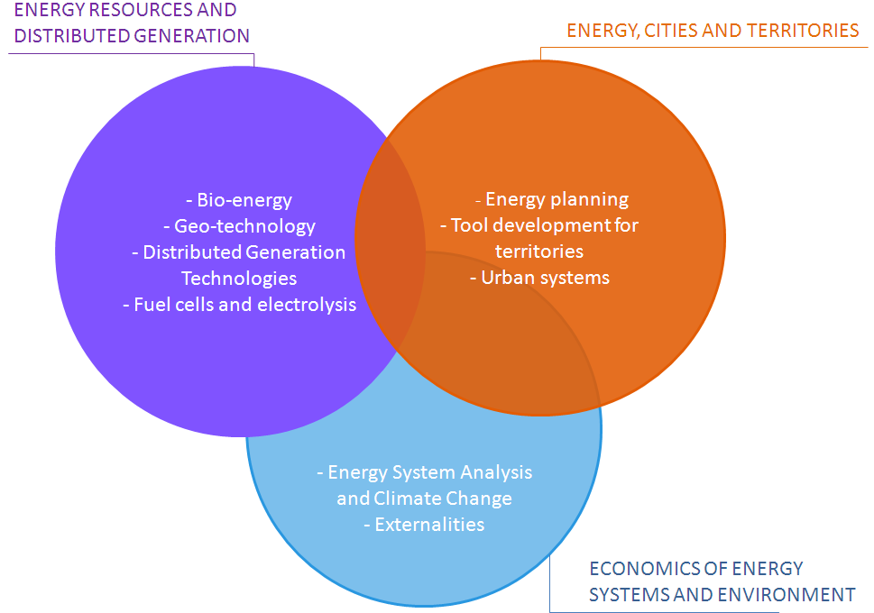
            EIFER
            European Institute For Energy Research
120 Employees, 92 Researcher (20 PhD Students)
40% French, 40% German and 20% other nationalities
European Economic Interest Grouping of
EDF and KIT
Energy Planning & Geosimulation
30 Researchers, (9 PhD, 8 PhD candidates)

Slide 4
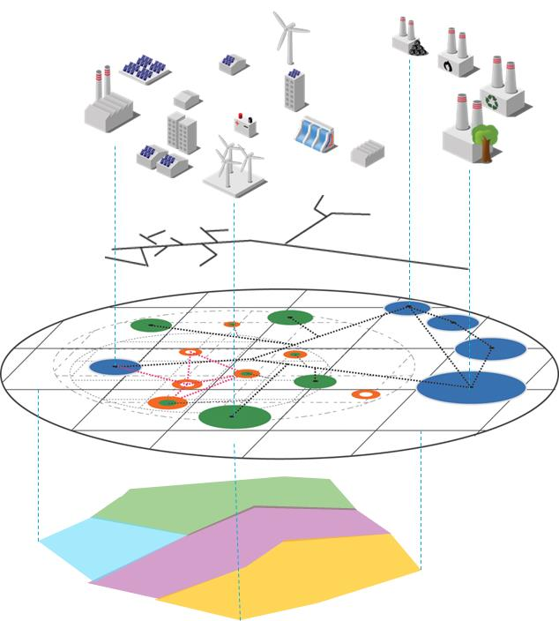
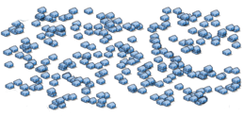
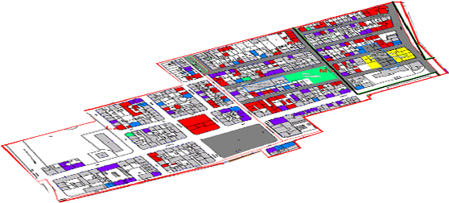

            EIFER
            Energy Planning & Geosimulation
Energy System Components
Component models
Energy infrastructure
Energy balance
Data Analysis Management
Spatial data model
Communication services
Data structure
Urban Planning
Land use planning
Urban planning instruments
GIS
Group is involved in standardization committees, such as the ICA to the OGC

Slide 5
            Workshop participants

Slide 6



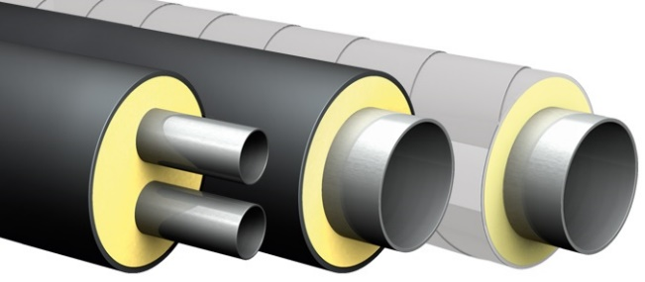


            City wide energy chain
Production
Utility Networks
Consumption
Fossil based
Renewables
Industrial processes
Nuclear
Tertiary
Housing
Industrial
Electrical
District Cooling
District Heating
Waste water
Gas
Steam
Oil

Slide 7
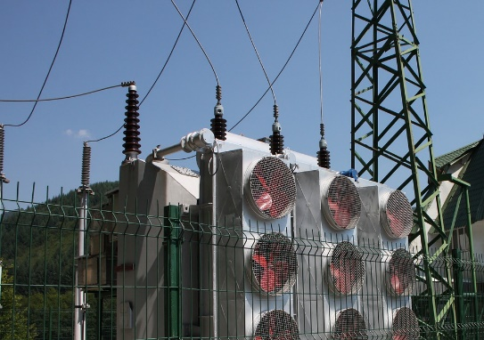
            Integrated approach to modelling the entire energy chain on a city scale
Energy Production facility
House / District / Neighborhood / Town / City
Utility Network
Utility Network
Substation
Majority of modelling/simulation situation from substation to production facility
Modelling of demand at house/district/neighbourhood level

Slide 8


            City models
EnergyADE
CityGML
UtilityNetworkADE

Slide 9
            ADE’s
Application Domain Extension
Standard extended for specific applications starting from the UML
UML modeling approach for ADE’s
EIFER has made 2017 the EIFER-ADE year by hosting:
March UtilityNetworkADE
December The common EnergyADE and the UtilityNetworkADE
ADE

Slide 10
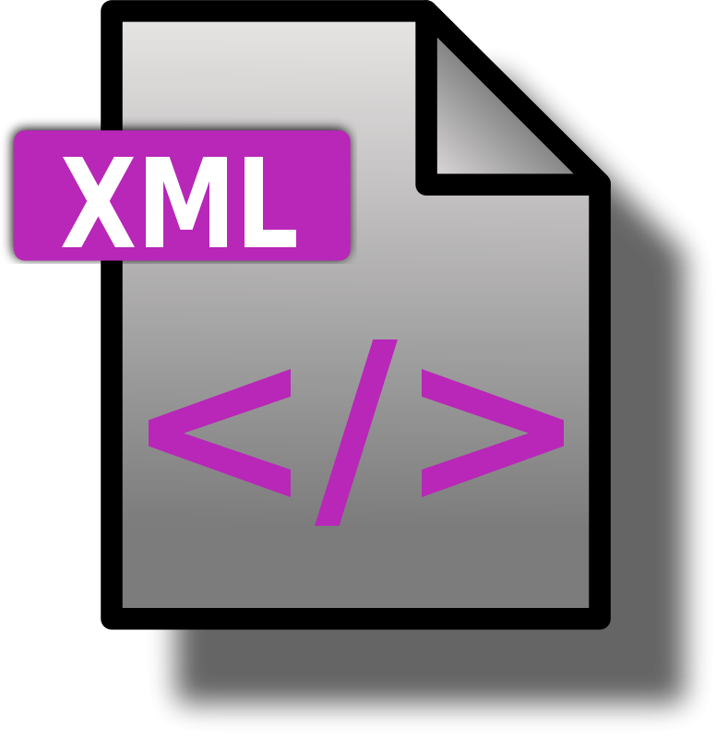
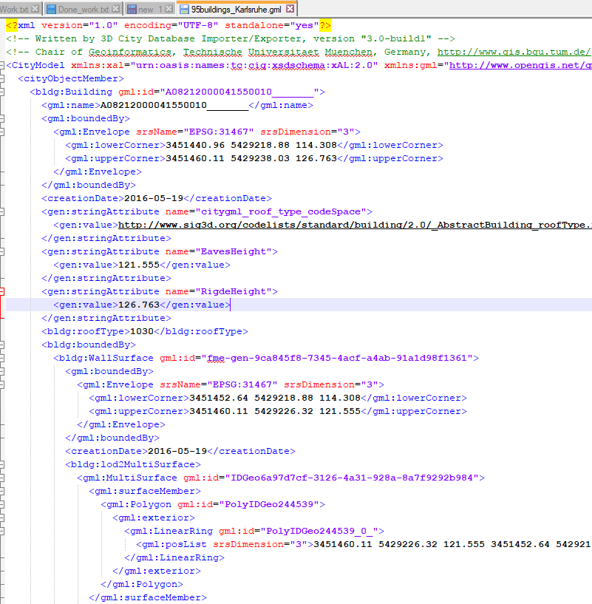
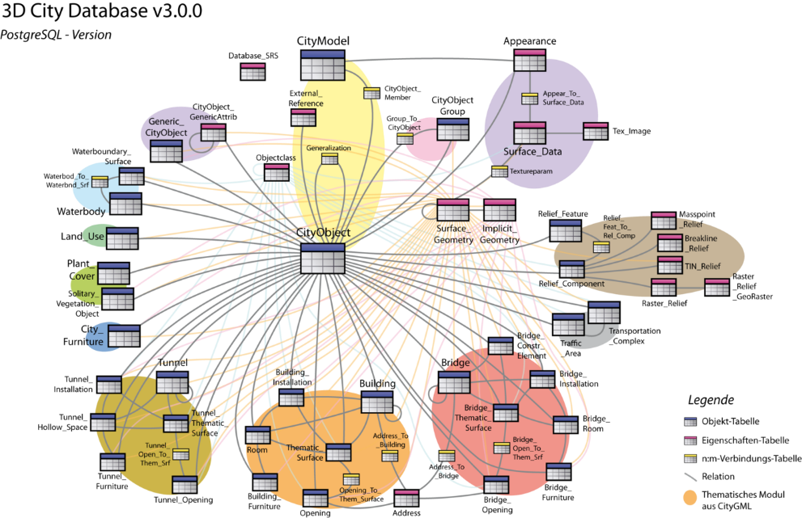
            EnergyADE
XML usage
KIT GebSim (via IFC Explorer)
RTWH Aachen Teaser
TUM EnergieAtlas
HfT Stuttgart SimStadt
Enercity
EIFER aEneAs
Relational DB usage

